Slide 1

P2P system with TCP protocol
Chaw Thiri San
12225272
4/12/2023

Slide 2
Table of contents
1)Source code explanation for P2P system
2)Visualization in CISCO package tracer
3)Tracing the file in Wireshark

Slide 3
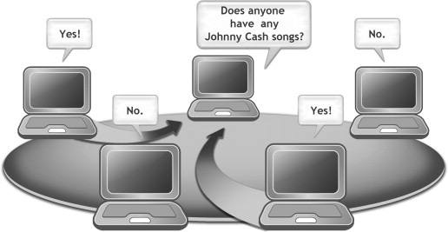
Python code for P2P systems
Features
P2P system (Peer-to-Peer Network)
TCP protocol
Latency Measurement
Timeout
File transfer

Slide 4
What is P2P system?
Definition: Peer-to-peer (P2P) systems facilitate decentralized communication and resource-sharing among interconnected nodes.
Characteristics:
  Absence of a central server
  Direct communication between peers
  Each node acts as both a client and a server

Slide 5
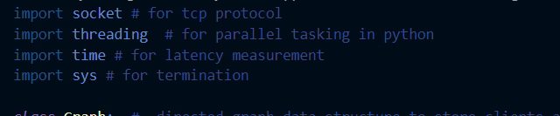
Code explanation
Libraries used
Parts
Classes
  Graph : for storing nodes
  Peer : for networking
  Main function

Slide 6
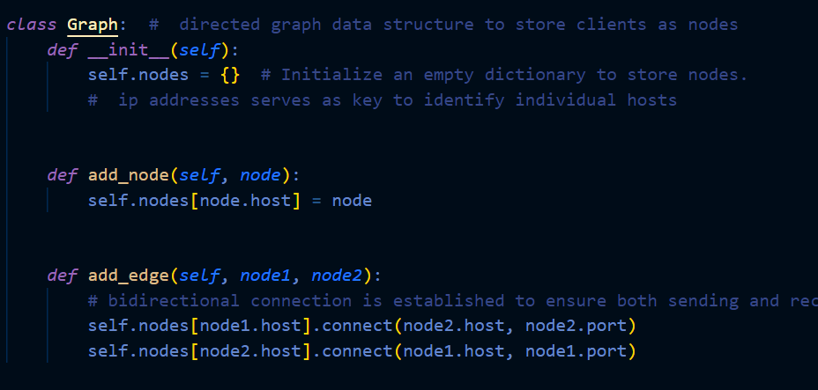
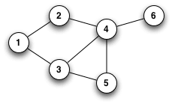
Storing the node connections
Undirected Graph

Slide 7
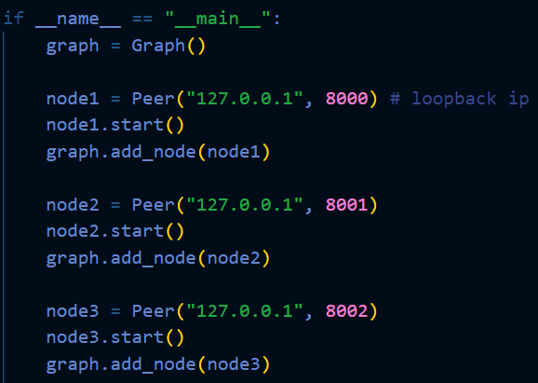
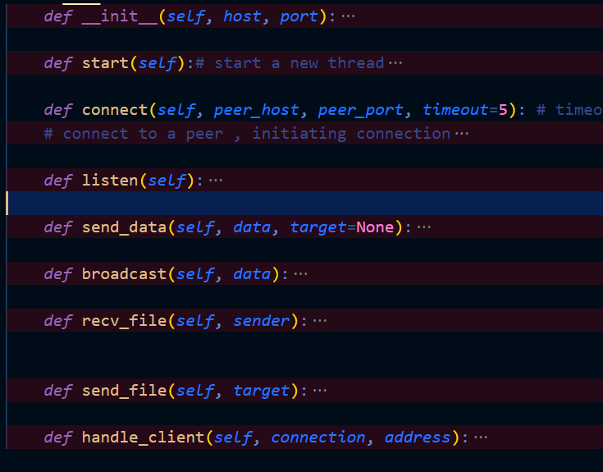
Peer class
- established 3 nodes to represent 3 end devices.
- used a loopback IP address so that it can be tested in a single machine.
- used various port numbers to avoid port errors.

Slide 8
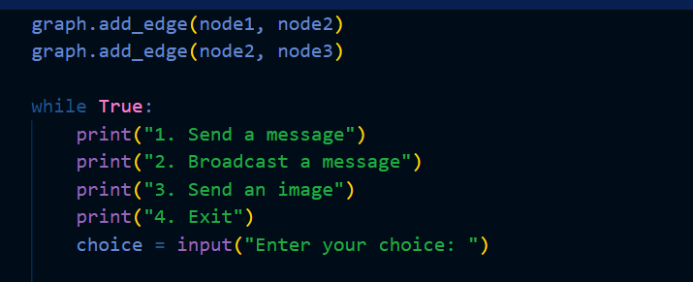
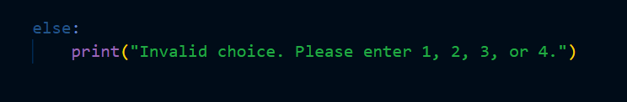
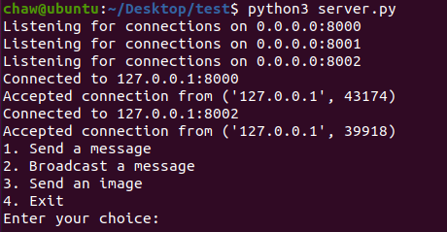
Establish a bidirectional connection
All connected nodes can both
Send and Receive file.
Our program can perform 3 things:
Send a unicast message.
Send a broadcast message.
Send a unicast file transfer(demonstration uses an image file.)
Exit to stop all the processes
Added error handling

Slide 9
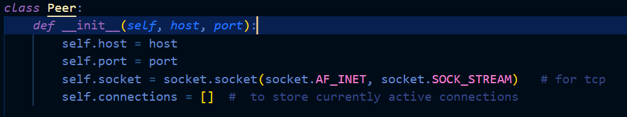
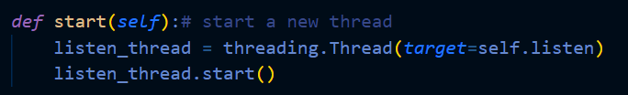
Ip address and port number

Slide 10
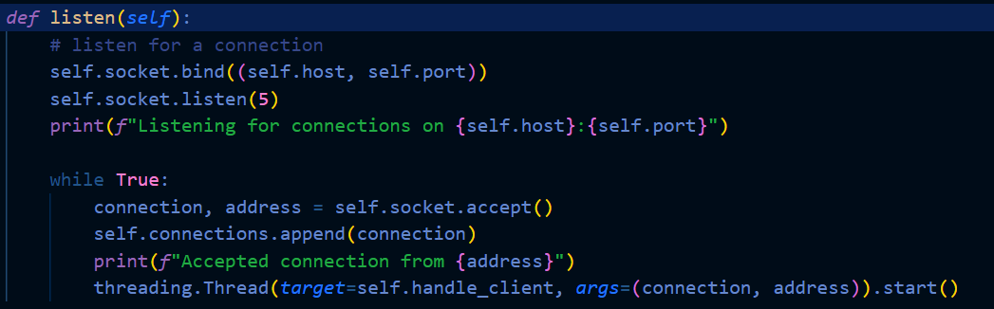
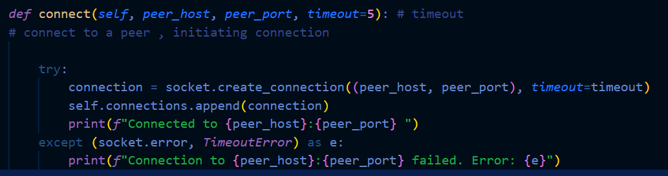
Peer that will acts as server
Peer that acts as a client
Connection Establishing

Slide 11
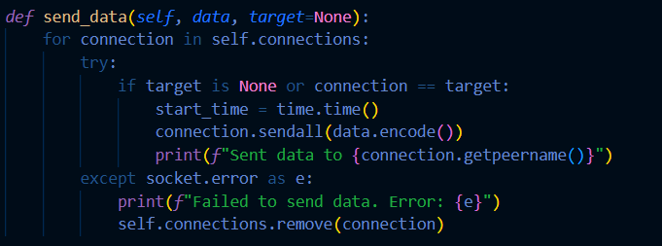
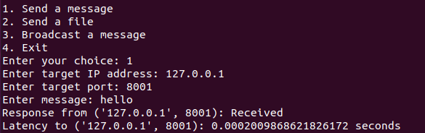
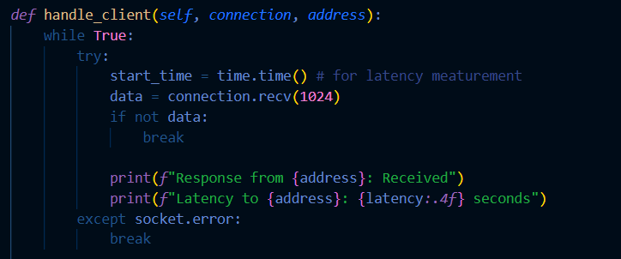

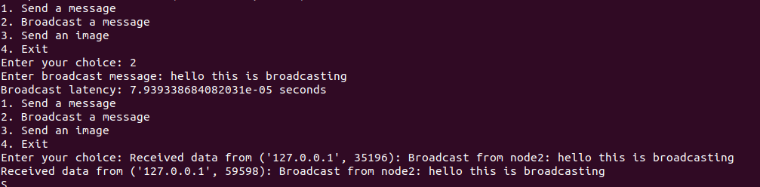
For unicast message transmission
For latency measurement
For broadcasting

Slide 12



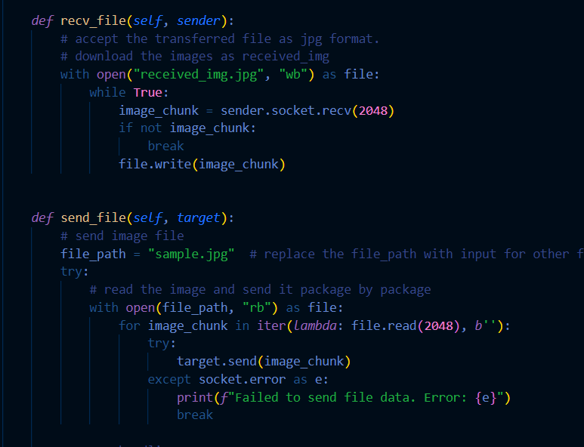


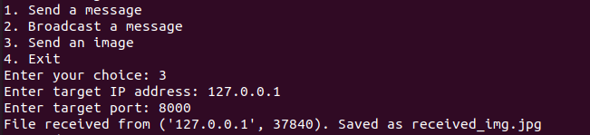

File transfer
- tested with image(jpeg file)
- Image visualization not successful
- Download the file

Slide 13

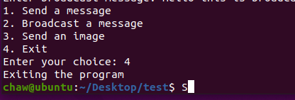
Ending the program

Slide 14


Explanation of the network
To the CISCO Package Tracer

Slide 15
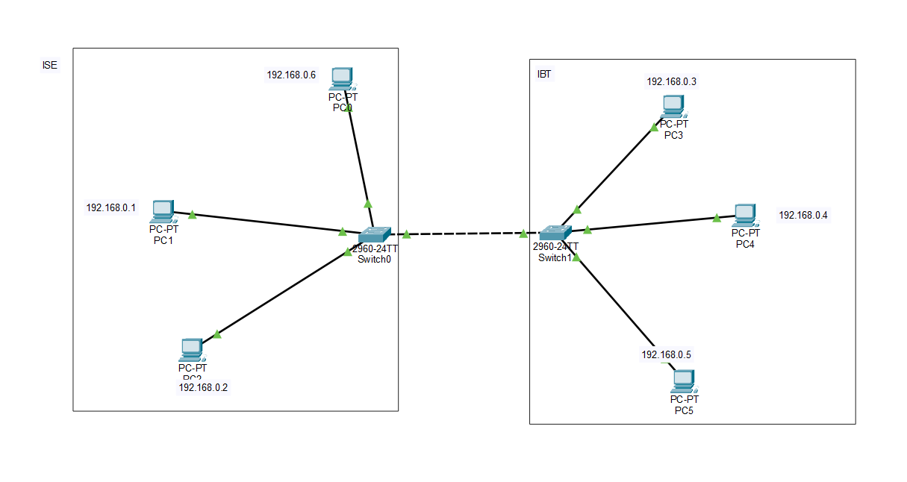
P2P network established in our SGCS department

Slide 16

Tracing the file in Wireshark
Part 3

Slide 17
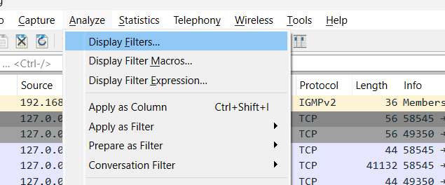
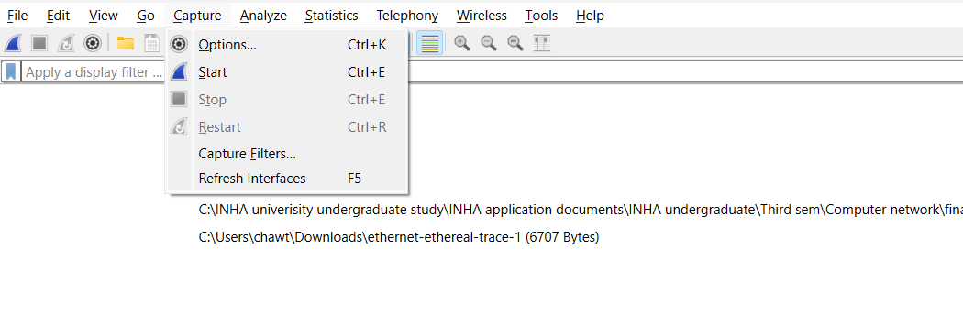
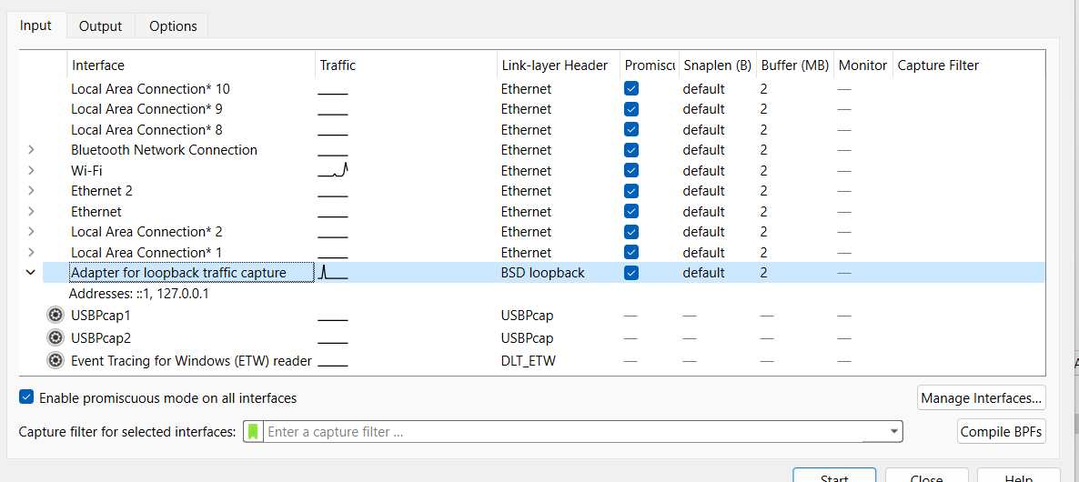
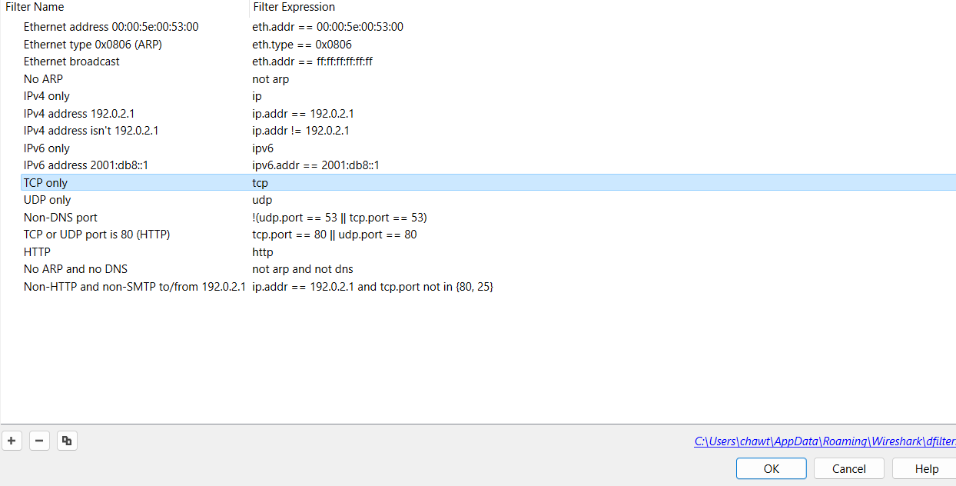
Steps by steps

Slide 18
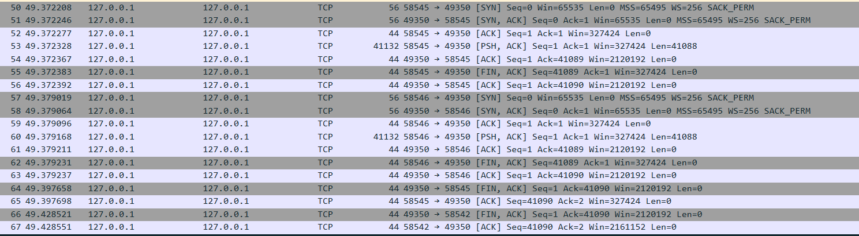
Wireshark packages after filtering the TCP protocol only

Slide 19
The first packet (Line 50) is a SYN packet sent by the source to initiate the connection.
The second packet (Line 51) is a SYN-ACK packet sent by the destination to acknowledge the request initiate its connection.
The third packet (Line 52) is an ACK packet sent by the source to acknowledge the receipt of the SYN-ACK.
TCP three-way handshake
The client sends a TCP packet with the SYN flag set to the server to initiate a connection.
The server responds with a TCP packet that has both the SYN and ACK flags set, indicating acknowledgment of the connection request and initiation of its own connection.
Finally, the client sends a TCP packet with the ACK flag set, acknowledging the server's response. At this point, the connection is established.
When the PSH flag is set, it indicates that the sender wants the data to be pushed to the receiving application immediately.

Slide 20
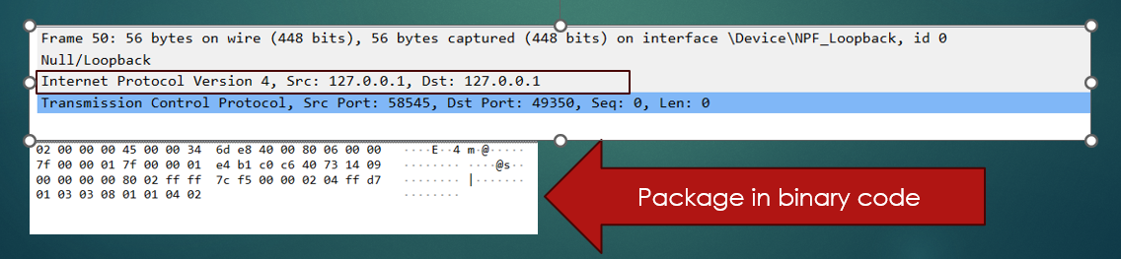
Looking into frame 50

Slide 21
Thank you

